Slide 1
Network Programming Lab

Slide 2
Goals for the Lab
Reuse socket addresses.

Slide 3
Libraries Used
Socket
Sys

Slide 4
Reuse socket addresses
You want to run a socket server always on a specific port even after it is closed intentionally or unexpectedly.
This is useful in some cases where your client program always connects to that specific server port.
So, you don't need to change the server port.

Slide 5
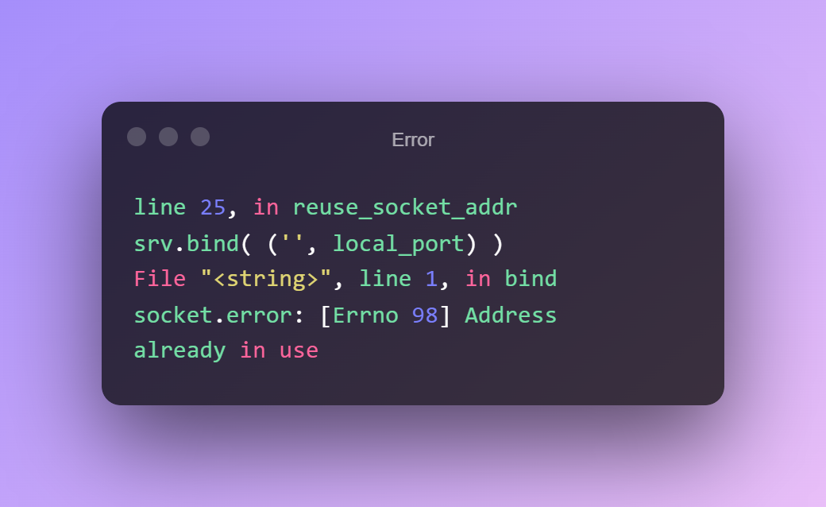
Error

Slide 6
Contd..
The remedy to this problem is to enable the socket reuse option, SO_REUSEADDR.
After creating a socket object, we can query the state of address reuse, say an old state.
Then, we call the setsockopt() method to alter the value of its address reuse state.
Then, we follow the usual steps of binding to an address and listening for incoming client connections.

Slide 7
Contd.
Use Keyboard Interrupt with the help of Try and Except to implement it.
You may run the script from one console window and try to connect to this server from another console window by typing telnet localhost 8383(Set this on your code as local port).
Bind the local port and set listen to 1.

Slide 8
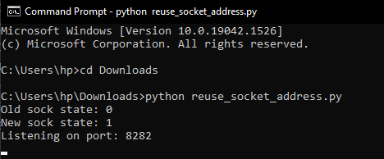
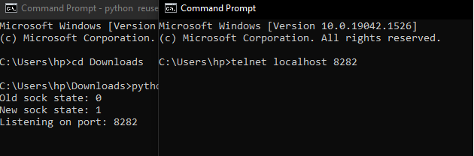
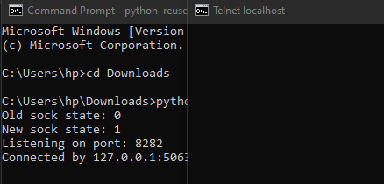
Contd.

Slide 9
Problem Statement
Write a program that demonstrates the reuse socket addresses?

